Slide 1
UNIT – V : COMMUNICATION SYSTEMS

Slide 2



Signal and System
Signals are variables that carry information
System is an assemblage of entities real or abstract, comprising a whole with each every component/element interacting or related to another one.
Systems process input signals to produce output signals
Examples
  Motion, sound, picture, video, traffic light…
  Natural system (ecosystem), human-made system (machines, computer storage system), abstract system (traffic, computer programs), descriptive system (plans)
Notes:
Natural Systems: These are systems like the ecosystem, blood system and solar system.
Human-made System: These systems include not designed and designed physical systems such as: machines, industrial plants, telecomunication infrastructure networks, computer storage systems and modern sculptures.
Abstract Systems: Every conceptual model is an abstract system, for example, traffic system models and computer programs are both types of modeled systems. They can be the product of identification, design or invention.
Descriptive and Normative Systems: They relates to human and other living system activity, an example of these are; plans, bus/train timetable, ethical systems.

Slide 3
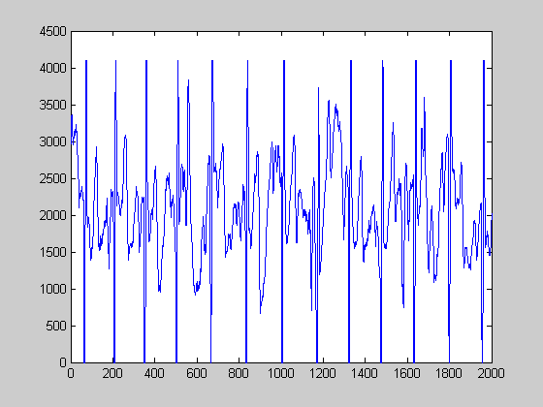
Signal Examples
Electrical signals --- voltages and currents in a circuit
Acoustic signals --- audio or speech signals (analog or digital)
Video signals --- intensity variations in an image (e.g. a CAT scan)
Biological signals --- sequence of bases in a gene
Noise: unwanted signal
:

Slide 4




Analog Signals
Human Voice – best example
Ear recognises sounds 20KHz or less
AM Radio – 535KHz to 1605KHz
FM Radio – 88MHz to 108MHz

Slide 5
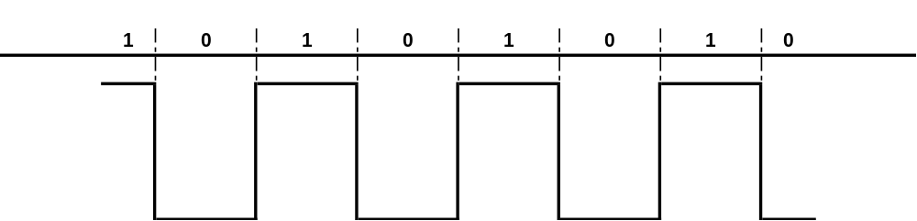
Digital signals
Represented by Square Wave
All data represented by binary values
Single Binary Digit – Bit
Transmission of contiguous group of bits is a bit stream
Not all decimal values can be represented by binary

Slide 6
How transmissions flow over media
Simplex – only in one direction
Half-Duplex – Travels in either direction, but not both directions at the same time
Full-Duplex – can travel in either direction simultaneously

Slide 7
What is a communications system?
Communications Systems: Systems designed to transmit and receive information
Info
Source
Info
Sink
Comm
System

Slide 8
Elements of a Communication System
Input message
Output message
Input Transducer
Output Transducer
Transmitter
Channel
Receiver
Wired
wireless

Slide 9
Input Transducer: The message produced by a source must be converted by a transducer to a form suitable for the particular type of communication system.
Example: In electrical communications, speech waves are converted by a microphone to voltage variation.
Transmitter: The transmitter processes the input signal to produce a signal suits to the characteristics of the transmission channel.
Signal processing for transmission almost always involves modulation and may also include coding. In addition to modulation, other functions performed by the transmitter are amplification, filtering and coupling the modulated signal to the channel.

Slide 10
Channel: The channel can have different forms: The atmosphere (or free space), coaxial cable, fiber optic, waveguide, etc.
The signal undergoes some amount of degradation from noise, interference and distortion
Receiver: The receiver’s function is to extract the desired signal from the received signal at the channel output and to convert it to a form suitable for the output transducer.
Other functions performed by the receiver: amplification (the received signal may be extremely weak), demodulation and filtering.
Output Transducer: Converts the electric signal at its input into the form desired by the system user.
Example: Loudspeaker, personal computer (PC), tape recorders.

Slide 11

Comm. Sys. Bock Diagram
Noise
m(t)
Tx
Channel
Rx
s(t)
r(t)
Baseband
Signal
Baseband
Signal
Bandpass
Signal
“Low” Frequencies
<20 kHz
Original data rate
“High” Frequencies
>300 kHz
Transmission data rate
Demodulation
or
Detection
Modulation
Formal definitions will be provided later

Slide 12
Need of Modulation
You may be ask, when the baseband signal can be transmitted directly why to use the modulation ?
The answer is that the baseband transmission has many limitations which can be overcome using modulation . It is explained below .
In the process of modulation, the baseband signal is translated i.e., shifted from low frequency to high frequency . This frequency shift is proportional to the frequency of carrier.

Slide 13
Advantages of Modulation
Reduction in the height of antenna
Avoids mixing of signals
Increases the range of communication
Multiplexing is possible
Improves quality of reception

Slide 14

Reduction in the height of antenna
For the transmission of radio signals, the antenna height must be multiple of λ/4 ,where λ is the wavelength .
λ = c /f
where c : is the velocity of light
f: is the frequency of the signal to be transmitted
The minimum antenna height required to transmit a baseband signal of f = 10 kHz is calculated as follows :
The antenna of this height is practically impossible to install .

Slide 15
Now, let us consider a modulated signal at f = 1 MHz . The minimum antenna height is given by,
This antenna can be easily installed practically . Thus, modulation reduces the height of the antenna .

Slide 16
2. Avoids mixing of signals
If the baseband sound signals are transmitted without using the modulation by more than one transmitter, then all the signals will be in the same frequency range i.e. 0 to 20 kHz . Therefore, all the signals get mixed together and a receiver can not separate them from each other .
Hence, if each baseband sound signal is used to modulate a different carrier then they will occupy different slots in the frequency domain (different channels). Thus, modulation avoids mixing of signals .

Slide 17
3. Increase the Range of Communication
The frequency of baseband signal is low, and the low frequency signals can not travel long distance when they are transmitted . They get heavily attenuated .
The attenuation reduces with increase in frequency of the transmitted signal, and they travel longer distance .
The modulation process increases the frequency of the signal to be transmitted . Therefore, it increases the range of communication.

Slide 18
4. Multiplexing is possible
Multiplexing is a process in which two or more signals can be transmitted over the same communication channel simultaneously .
This is possible only with modulation.
The multiplexing allows the same channel to be used by many signals . Hence, many TV channels can use the same frequency range, without getting mixed with each other or different frequency signals can be transmitted at the same time .
5. Improves Quality of Reception
With frequency modulation (FM) and the digital communication techniques such as PCM, the effect of noise is reduced to a great extent . This improves quality of reception .

Slide 19
Telecommunication
Telegraph
Fixed line telephone
Cable
Wired networks
Internet
Fiber communications
Communication bus inside computers to communicate between CPU and memory

Slide 20
Wireless Communications
Satellite
TV
Cordless phone
Cellular phone
Wireless LAN, WIFI
Wireless MAN, WIMAX
Bluetooth
Ultra Wide Band
Wireless Laser
Microwave
GPS
Ad hoc/Sensor Networks

Slide 21
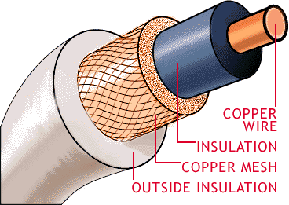
Coaxial Cable
First type of networking media used
Available in different types (RG-6 – Cable TV, RG58/U – Thin Ethernet, RG8 – Thick Ethernet
Largely replaced by twisted pair for networks

Slide 22
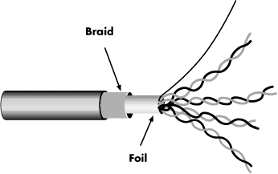
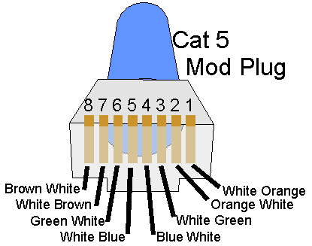
Unshielded Twisted Pair
Advantages
  Inexpensive
  Easy to terminate
  Widely used, tested
  Supports many network types
Disadvantages
  Susceptible to interference
  Prone to damage during installation
  Distance limitations not understood or followed

Slide 23
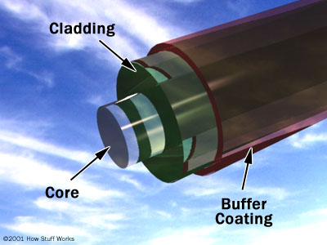
Glass Media--OFC
Core of silica, extruded glass or plastic
Single-mode is 0.06 of a micron in diameter
Multimode = 0.5 microns
Cladding can be Kevlar, fibreglass or even steel
Outer coating made from fire-proof plastic
Advantages
  Can be installed over long distances
  Provides large amounts of bandwidth
  Not susceptible to EMI RFI
  Can not be easily tapped (secure)
Disadvantages
  Most expensive media to purchase and install
  Rigorous guidelines for installation

Slide 24
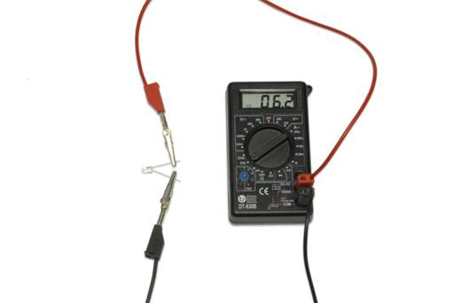
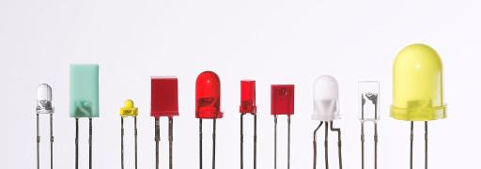
Fibre optic systems use light
A simple transmitter: button cell & LED
A simple detector:
phototransistor + multimeter
Infrared light is used more commonly than visible light - less attenuation and dispersion.
Notes:
https://commons.wikimedia.org/wiki/File:Verschiedene_LEDs.jpg

Slide 25
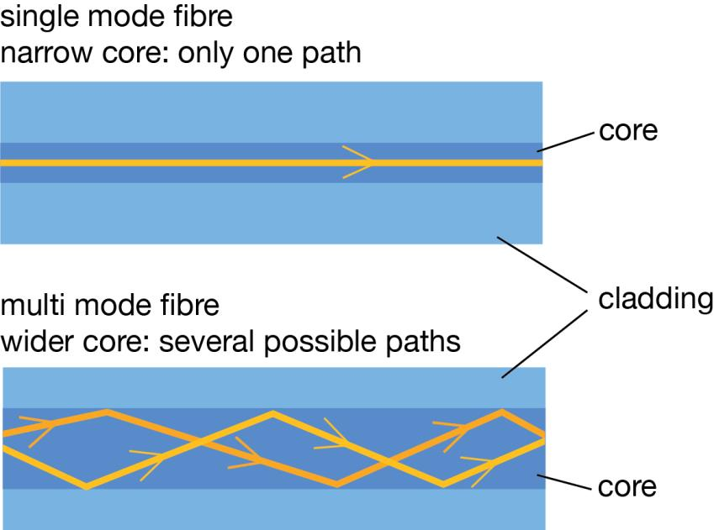
Constructing optical fibres
Two kinds of fibre are used.
long
distances
within a building

Slide 26
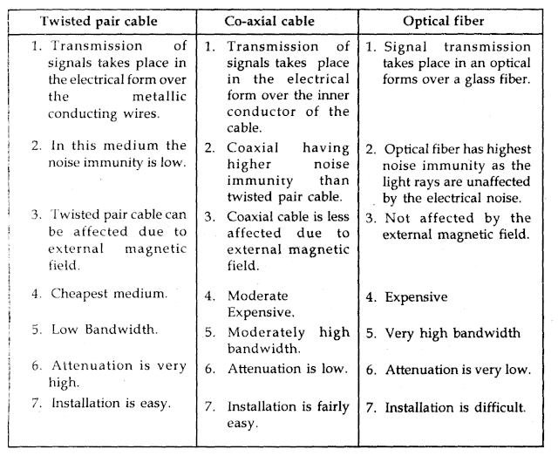

Slide 27
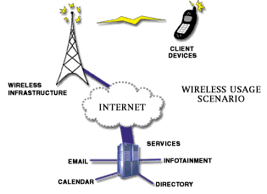

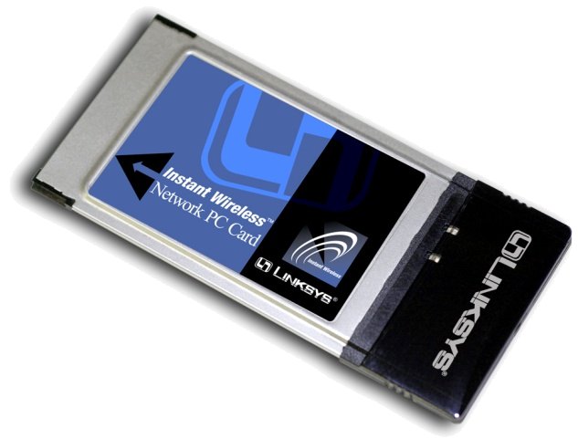
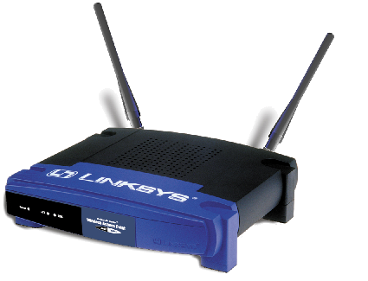
Wireless

Slide 28
Wireless (2)
Radio transmits at 10KHz to 1KHz
Microwaves transmit at 1GHz to 500GHz
Infrared transmits at 500GHz to 1THz
Radio transmission may include:
  Narrow band
  High-powered
  Frequency hopping spread spectrum (the hop is controlled by accurate timing)
  Direct-sequence-modulation spread spectrum (uses multiple frequencies at the same time, transmitting data in ‘chips’ at high speed)

Slide 29
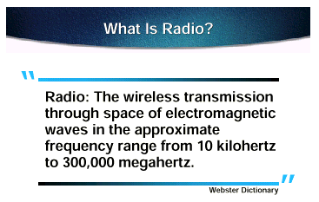

Slide 30
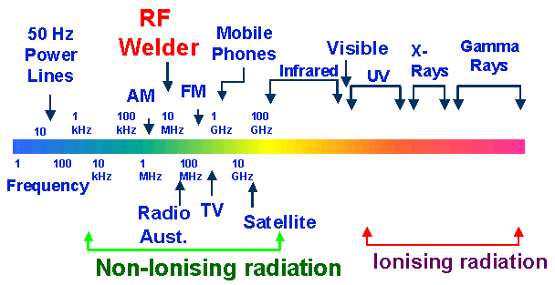
Frequency spectrum

Slide 31
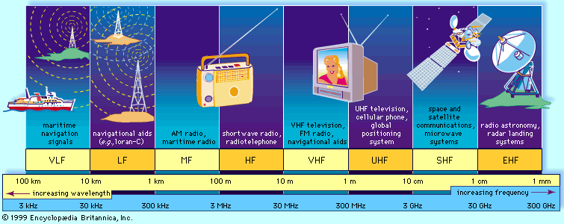
Frequency spectrum

Slide 32
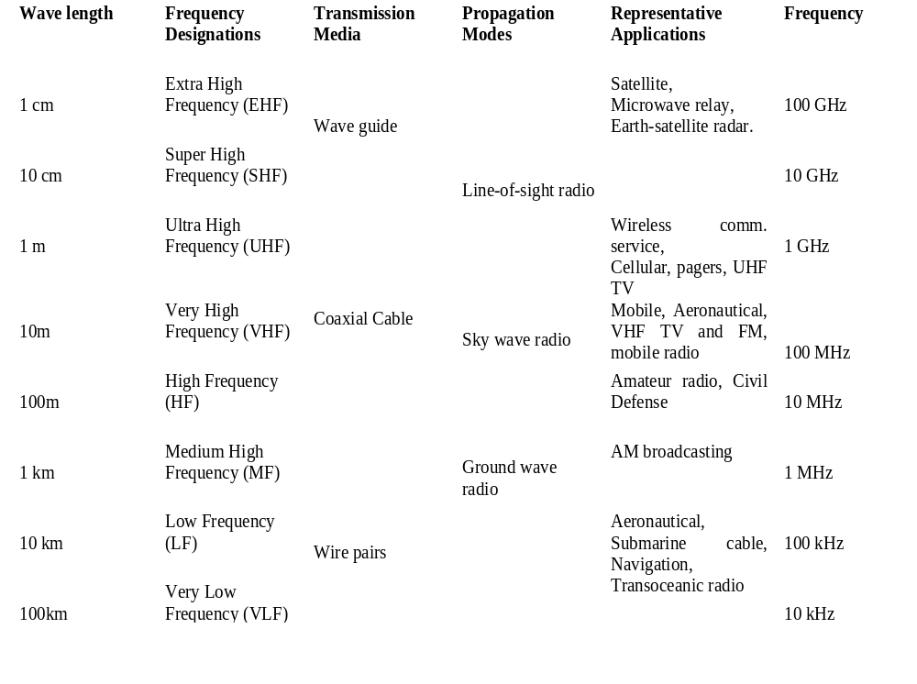

Slide 33
Amplitude Modulation
This is the simplest and oldest form of modulation. In this type, the information signal (intelligence) causes the amplitude of the carrier to vary in time, in proportion to the instantaneous magnitude of their sum

Slide 34
What is Modulation
Modulation
  In the modulation process, some characteristic of a high-frequency carrier signal (bandpass), is changed according to the instantaneous amplitude of the information (baseband) signal.
Why Modulation
  Suitable for signal transmission (distance…etc)
  Multiple signals transmitted on the same channel
  Capacitive or inductive devices require high frequency AC input (carrier) to operate.
  Stability and noise rejection

Slide 35
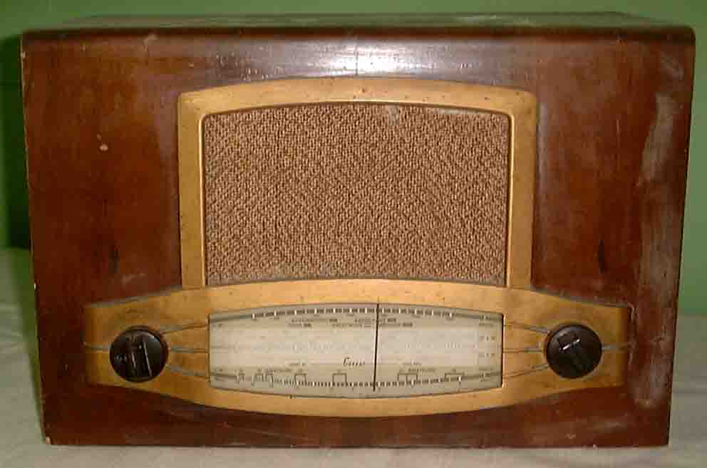
About Modulation
Application Examples
  broadcasting of both audio and video signals.
  Mobile radio communications, such as cell phone.
Basic Modulation Types
  Amplitude Modulation: changes the amplitude.
  Frequency Modulation: changes the frequency.
  Phase Modulation: changes the phase.

Slide 36
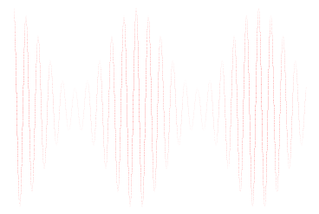

AM Modulation/Demodulation
Source
Sink
Channel
Modulator
Demodulator
Baseband Signal
with frequency
fm
(Modulating Signal)
Bandpass Signal
with frequency
fc
(Modulated Signal)
Original Signal
with frequency
fm
fc >> fm
Voice: 300-3400Hz GSM Cell phone: 900/1800MHz

Slide 37
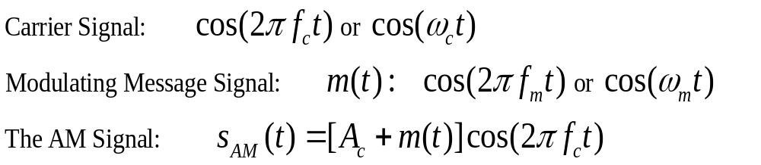
Amplitude Modulation
The amplitude of high-carrier signal is varied according to the instantaneous amplitude of the modulating message signal m(t).

Slide 38
Amplitude Modulation
The AM signal is generated using a multiplier.
All info is carried in the amplitude of the carrier, AM carrier signal has time-varying envelope.
In frequency domain the AM waveform are the lower-side frequency/band (f_{c} - f_{m}), the carrier frequency f_{c}, the upper-side frequency/band (f_{c} + f_{m}).

Slide 39
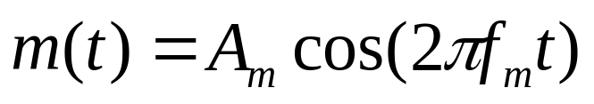

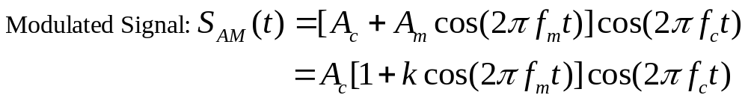
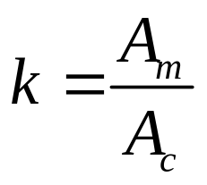
Modulation Index of AM Signal
For a sinusoidal message signal
Modulation Index is defined as:
Modulation index k is a measure of the extent to which a carrier voltage is varied by the modulating signal. When k=0 no modulation, when k=1 100% modulation, when k>1 over modulation.

Slide 40
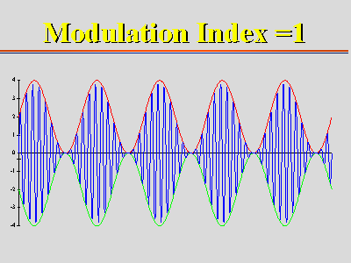
Modulation Index of AM Signal

Slide 41
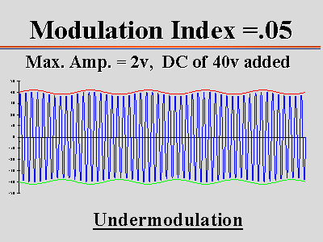
Modulation Index of AM Signal
CSULB May 22, 2006

Slide 42
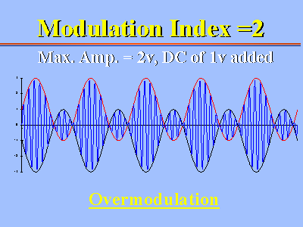
Modulation Index of AM Signal

Slide 43
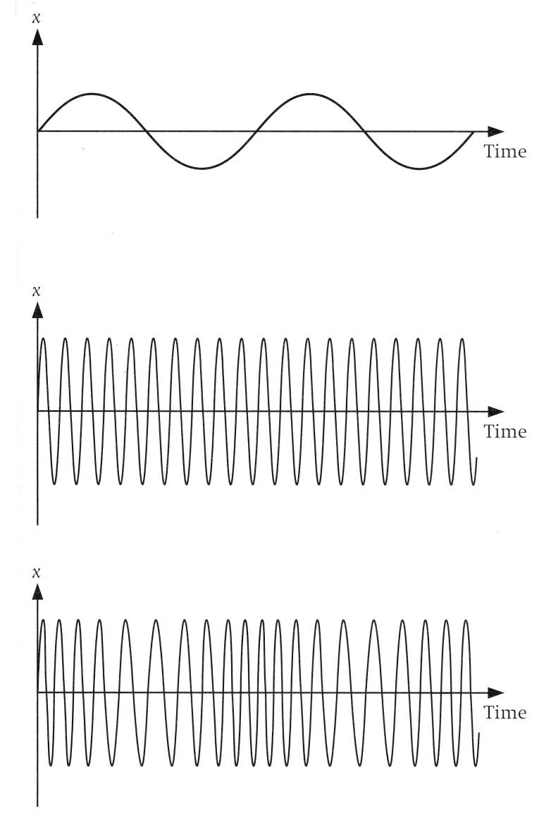
Frequency Modulation
In Frequency Modulation (FM) the instantaneous value of the information signal controls the frequency of the carrier wave. This is illustrated in the following diagrams.
Information Signal
Un-modulated carrier
Modulated carrier

Slide 44
Notice that as the amplitude of the information signal increases above 0 volts, the frequency of the carrier increases, and as the amplitude of the information signal decreases below 0 volts, the frequency of the carrier decreases.
The frequency f_{i} of the information signal controls the rate at which the carrier frequency increases and decreases. As with AM, f_{i} must be less than f_{c}. The amplitude of the carrier remains constant throughout this process.
When the information voltage reaches its maximum value then the change in frequency of the carrier will have also reached its maximum deviation above the nominal value. Similarly when the information reaches a minimum the carrier will be at its lowest frequency below the nominal carrier frequency value. When the information signal is zero, then no deviation of the carrier will occur.

Slide 45
The maximum change in frequency that can occur to the carrier from its base value f_{c} is called the frequency deviation, and is given the symbol Δf_{c}. This sets the dynamic range (i.e. voltage range) of the transmission.
The dynamic range is the ratio of the largest and smallest analogue information signals that can be transmitted.

Slide 46
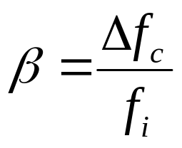
Modulation Index.
All FM transmissions are governed by a modulation index, β, which controls the dynamic range of the information being carried in the transmission. The modulation index, β, is the ratio of the frequency deviation, Δ f_{c} , to the maximum information frequency, f_{i} , as shown below:

Slide 47
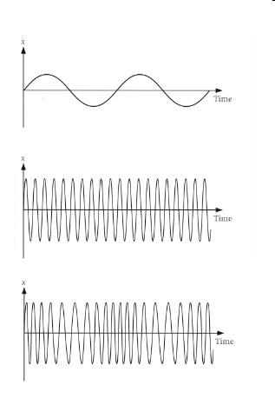
The diagrams opposite show examples of how the modulation index affects the FM output for a simple sinusoidal information signal of fixed frequency. The carrier signal has a frequency of ten times that of the information signal.
The first graph shows the information signal, the second shows the unmodulated carrier.
This graph shows the frequency modulated carrier when the modulation index = 3.

Slide 48
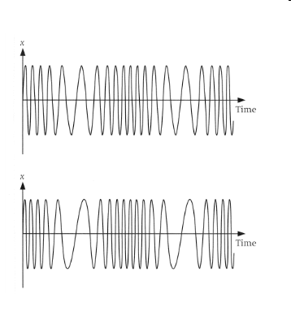
This graph shows the frequency modulated carrier when the modulation index = 5.
This graph shows the frequency modulated carrier when the modulation index = 7.
As the modulation index increases you should notice that the peaks of the high frequency get closer together and low frequency get further apart. For the same information signal therefore, the carrier signal has a higher maximum frequency.

Slide 49
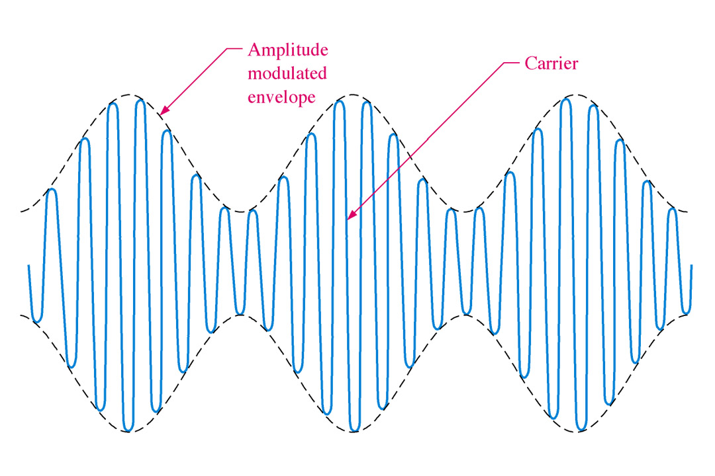
FIGURE 17-1 An example of an amplitude modulated signal. In this case, the higher-frequency carrier is modulated by a lower-frequency sinusoidal signal.

Slide 50
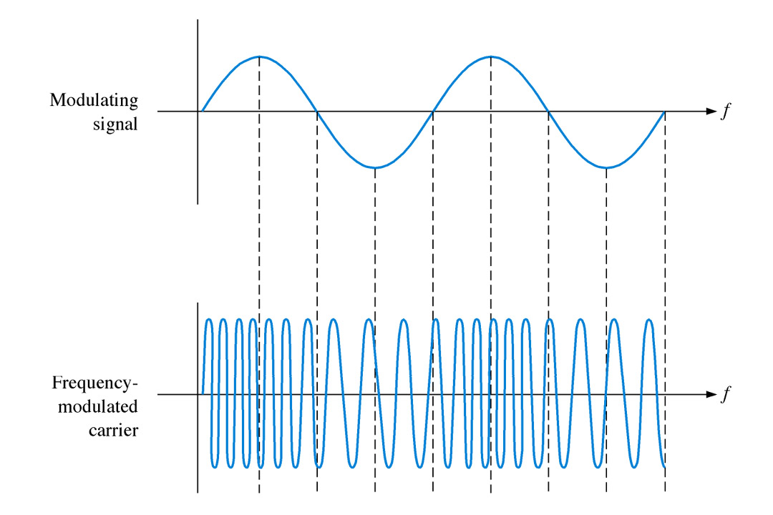
FIGURE 17-4 An example of frequency modulation.
Thomas L. Floyd
Electronic Devices, 6e and Electronic Devices: Electron Flow Version, 4e

Slide 51
GSM: Overview
GSM
  formerly: Groupe Spéciale Mobile (founded 1982)
  now: Global System for Mobile Communication
  simultaneous introduction of essential digital cellular services in three phases (1991, 1994, 1996) by the European telecommunication administrations, seamless roaming within Europe possible
  today many providers all over the world use GSM (more than 130 countries in Asia, Africa, Europe, Australia, America)

Slide 52
Performance characteristics of GSM
Communication
  mobile, wireless digital communication; support for voice and data services
Total mobility
  international access, chip-card enables use of access points of different providers
Worldwide connectivity
  one number, the network handles localization
High capacity
  better frequency efficiency, smaller cells, more customers per cell
High transmission quality
  high audio quality
  uninterrupted phone calls at higher speeds (e.g., from cars, trains) – better handoffs and
Security functions
  access control, authentication via chip-card and PIN

Slide 53
GSM: overview
OMC, EIR,
AUC
HLR
fixed network
GMSC
NSS
with OSS
VLR
MSC
VLR
MSC
BSC
BSC
RSS

Slide 54
GSM: cellular network
segmentation of the area into cells
possible radio coverage of the cell
idealized shape of the cell
cell
  use of several carrier frequencies
  not the same frequency in adjoining cells
  cell sizes vary from some 100 m up to 35 km depending on user density, geography, transceiver power etc.
  hexagonal shape of cells is idealized (cells overlap, shapes depend on geography)
  if a mobile user changes cells
  ⬇ handover of the connection to the neighbor cell

